Slide 1

Sprocket Central Pty Ltd
Data analytics approach

Slide 2
Agenda
The approach will be implemented in three stages :
Data Exploration
Model Development
Interpretation

Slide 3
Agenda
Approach for Customer Data analysis :
Age distribution
Bike purchase
Profit
Job industry
Number of cars owned

Slide 4
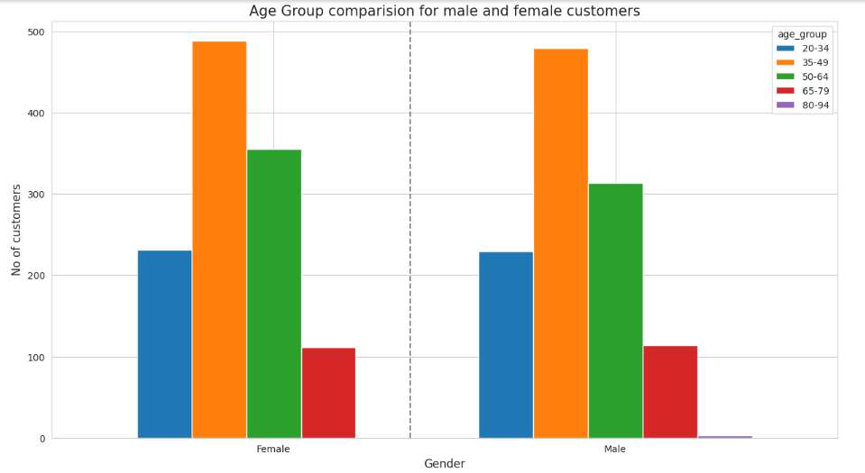
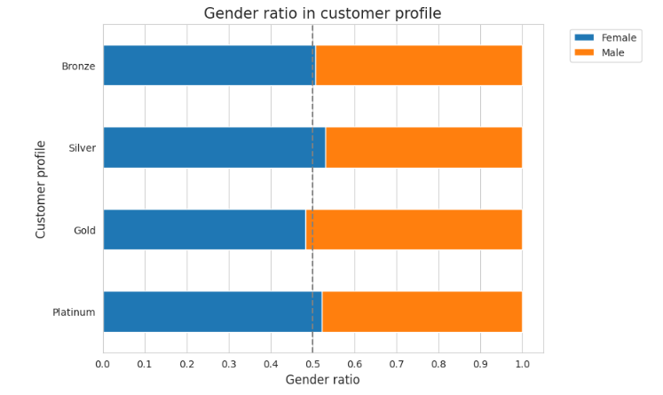
Data Exploration : Age Distribution
First graph compare the age group of men and female customers.
Both female and male customers are more from the age group of 35-49 and 50-64.
Fewer customer are from 20-34 & 65-79 for obvious reasons.
Second grapg shows the customers gender ratio based on customer profile.
The ratio of female customer is greater than men.
There is only one gold criteria where the male-to-female ratio is greater, whereas in all other criteria the female-to-male ratio is greater

Slide 5
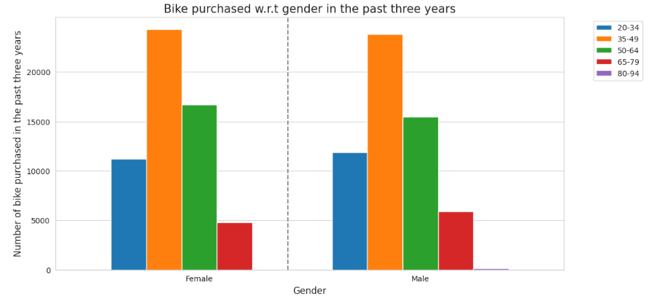
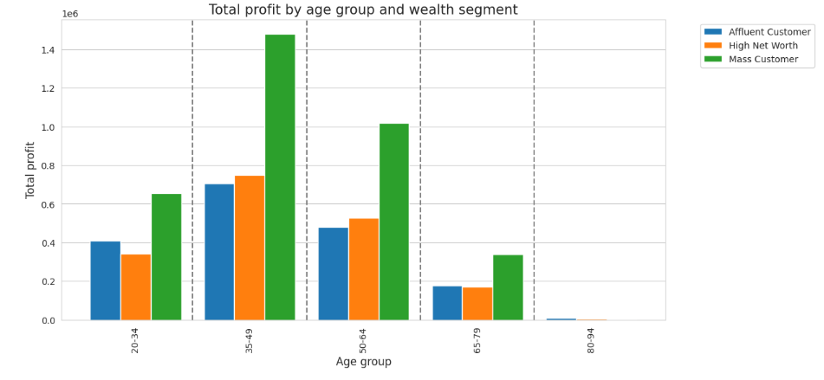
Data Exploration: Bike Purchases & Profit
An overview of bike purchases based on gender over the past three years is shown in the graph.
Data shows age group 35-49 has high count in terms of bike purchased in last 3 years with a slightly greater female ratio.
The target audience for our marketing should be inclined to provide focus on females than males.
Second graphs show the profits based on age group and wealth segmentation.
Mass customer segment is greater in every age group of customer.
For ages 35-49, company profits are high, for 65-79, they are less profitable, and for 80-94, profits are negligible

Slide 6
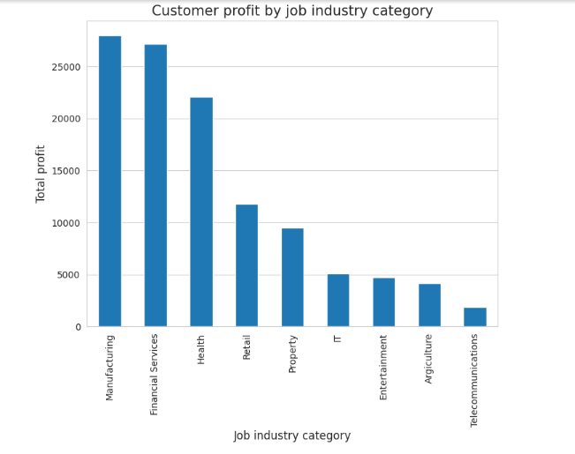
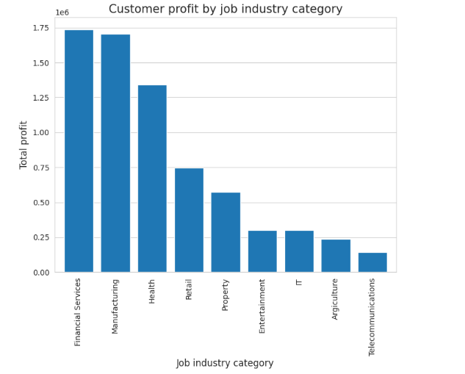
Data Exploration : Job Industry
The highest profits are also Financial Services, Manufacturing, and Health as seen in the second chart.
Financial Services, Manufacturing, and Health are the top three profit-generating industries, followed by retail and property.

Slide 7
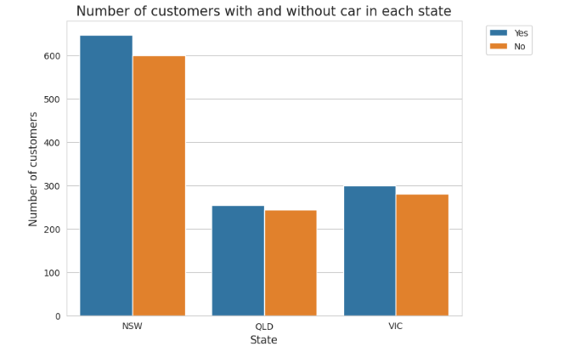
Data Exploration : Number of cars owned
The company might find potential market opportunities in New South Wales out of the three states.
New South Wales has the biggest potential since the number of people who own vehicles is nearly equal to the number of individuals who do not own cars, indicating that there is room for value customers there.
VIC and QLD has more customers that own car that who don’t but we can try to have something so that those owns car will buy bikes.

Slide 8
Model Development
CUSTOMER CLASSIFICATION – Targeting High Value Customers
The following are the high-value clients to target from the new list :
Aged between 35-49.
Owners of the vehicle.
Most of the high value customers are female compared to male.
Working in Financial Service, Manufacturing and Health.
Who are currently living in New South Wales and Victoria.

Slide 9
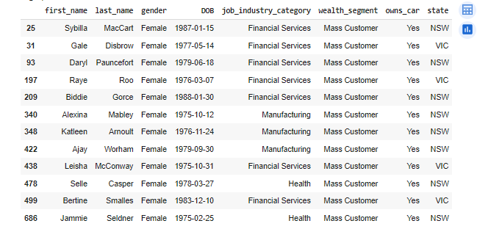
Interpretation
HIGH-VALUE CUSTOMER SUMMARY TABLE
For maximum value to the organization, 12 customers should be targeted

Slide 10
Note: The data and information in this document is reflective of a hypothetical situation and client. This document is to be used for KPMG Virtual Internship purposes only.
THANK YOU

